Slide 1


Da Vinci Satellite
High School Briefing Lecture

Slide 2
An Introduction to Satellite Communication

Slide 3
What are we going to talk about?
Why do satellites communicate?
How do satellites communicate?
What is modulation?
What are possible complications?

Slide 4
Why Do Satellites Communicate

Slide 5

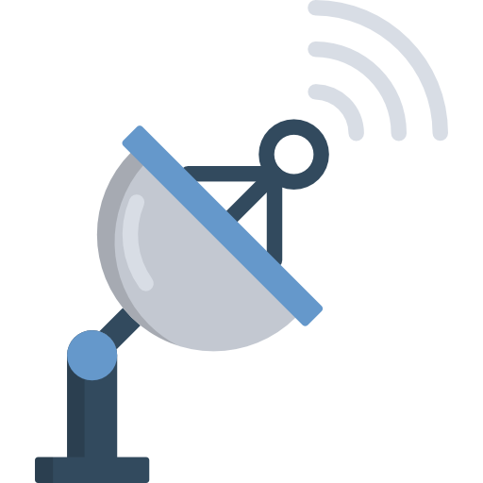
Why do Satellites Communicate?
We send information from/to the satellite when we communicate.
The reasons why we want to communicate is to
Track the satellite
Establish communication
Data exchange
Monitor and Control
Notes:
Tracking the satellite: to know where it is when in contact
Establish communication: to be able to communicate with different satellites or ground stations
Data exchange: when there is a software update, or the satellite has to send the data it has collected back
Monitor and Control: We can monitor whether the satellite is operational and correct its operations. For example, GPS satellites have clocks in them which can be different from the clocks on the ground due to relativity and they get corrected for their time delay.

Slide 6
How Do Satellites Communicate

Slide 7
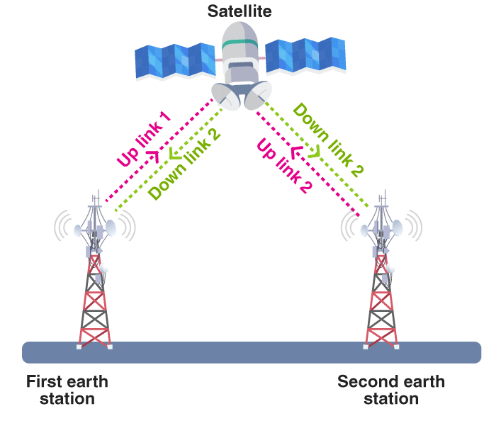
How do Satellites Communicate?
Main components:
Antenna dish on the satellite to receive and transmit
Pointer device on the satellite
Ground stations

Slide 8
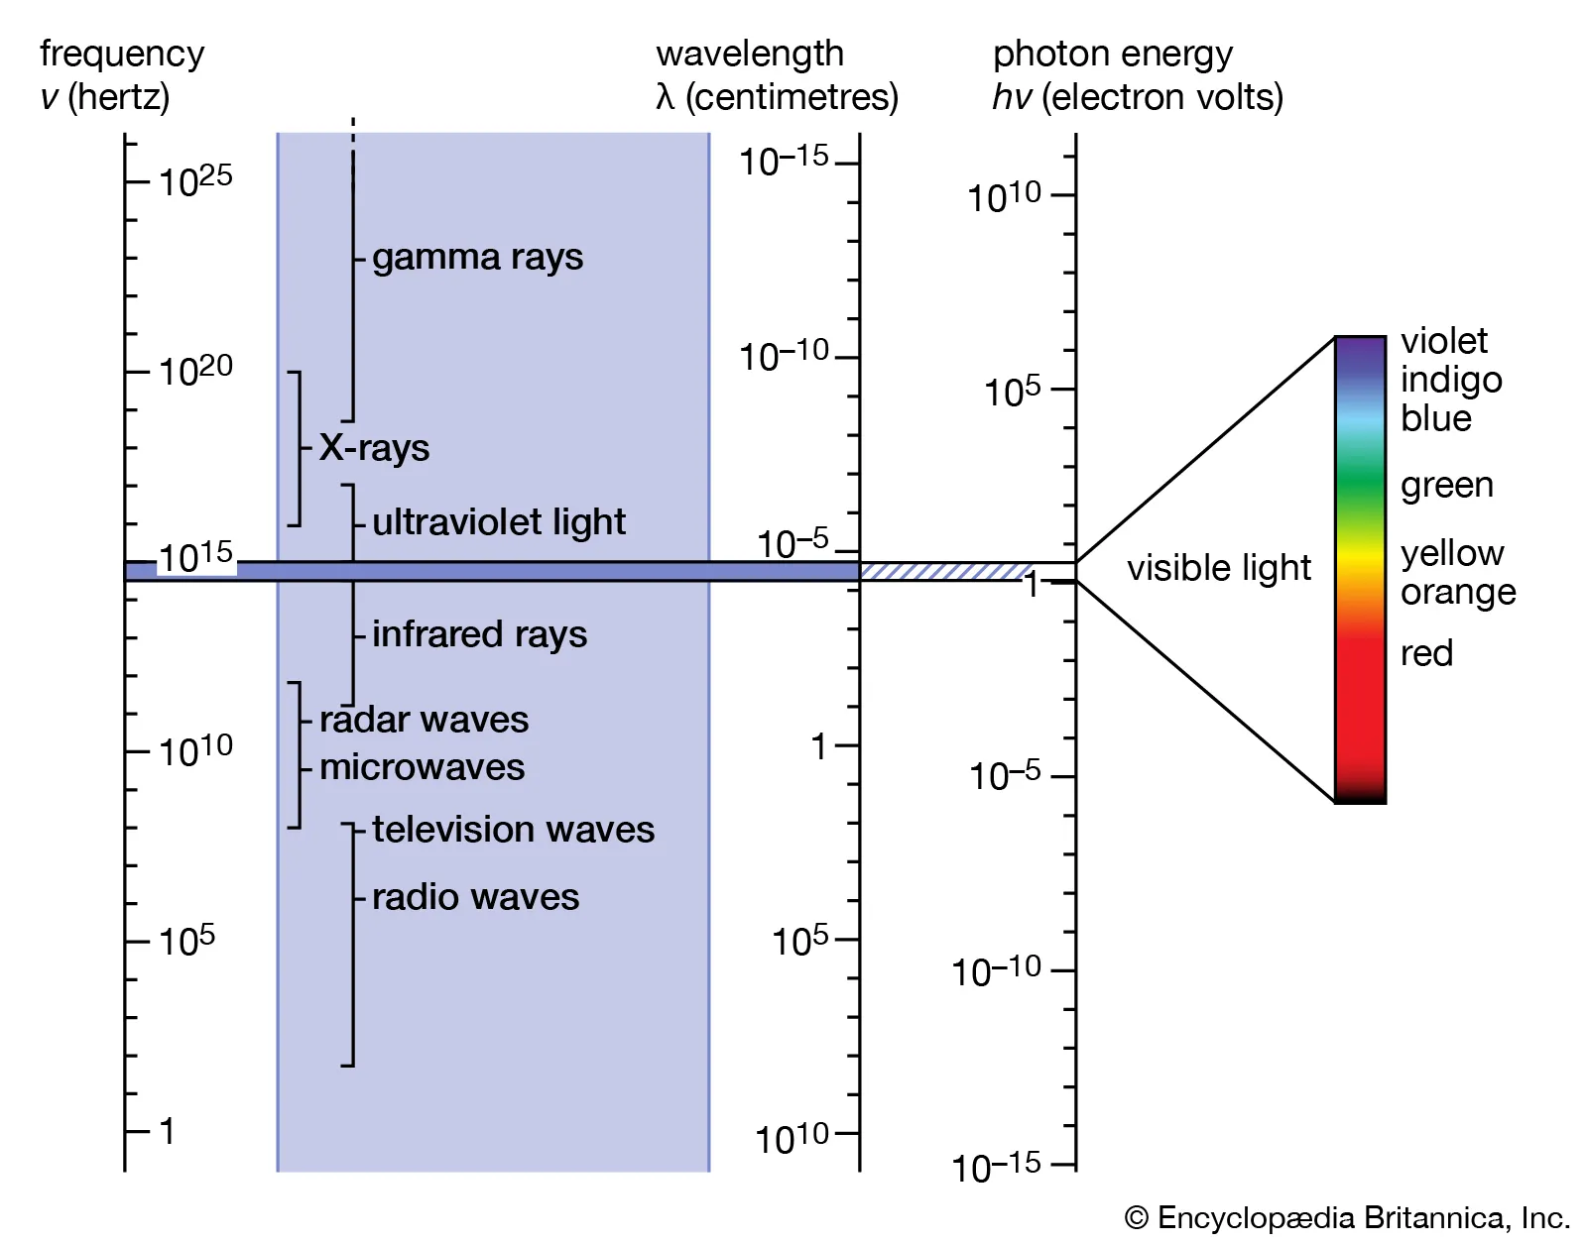
How do Satellites Communicate?
Satellites use high frequency waves to communicate with the ground station.
High frequency is key:
Information is not confused with noise
Less power needed
Notes:
There are two frequencies at which satellites send information:
Radar waves – used for GPS satellites and very long information ~6+ seconds
Radio waves – used for communication satellites to correct for minor errors
These are two frequency parts of the electromagnetic spectrum. They are electromagnetic waves that travel at the speed of light at different frequencies. The frequencies which we see are 10^15, whereas these frequencies are at 10^10 and 10^5 hence our eyes cannot see them!
There are two frequencies because of the equipment that is used on the satellite. Higher frequency means heavier equipment, which is NOT wanted.
With high frequency, we can transmit the information across with less power. Also, information will not be confused with noise. What is noise?
Noise is the equipment error, so very minute signal contributions that are added because of the electronics of the equipment
Noise is also because of the atmospheric conditions, and the reflection of the waves

Slide 9
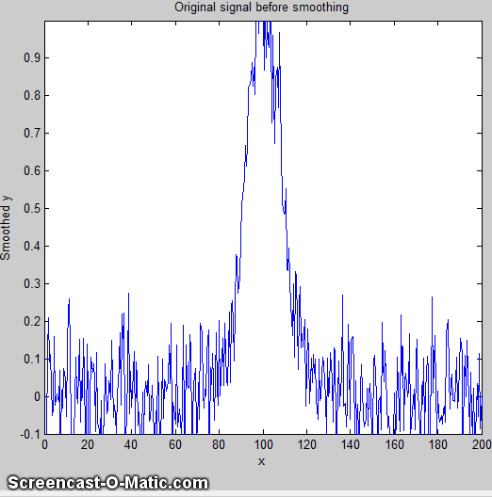
How do Satellites Communicate?
Notes:
The GIF shows what would happen if we LOWERED the signal frequency
The peak corresponds to the signal power we receive; the tails of the signal is the noise that is prevalent in the system.
As frequency is lowered, there is more contribution of noise in terms of the power contained in the signal.

Slide 10
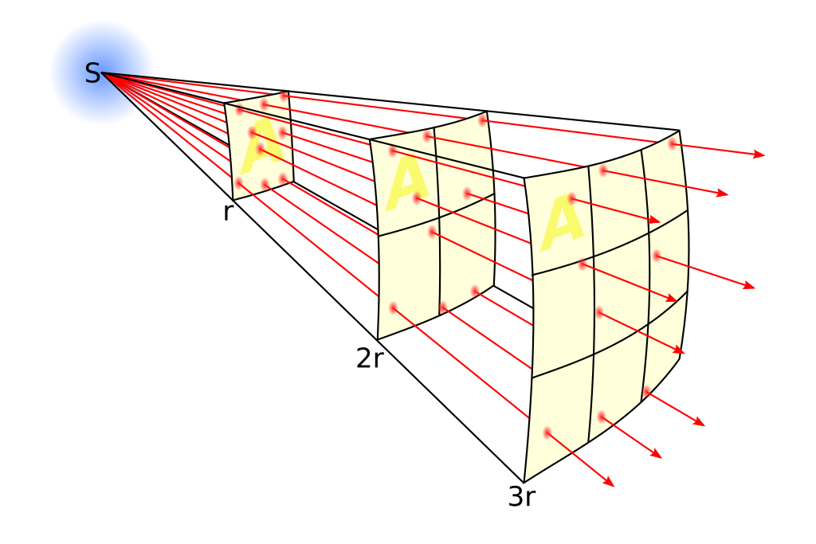
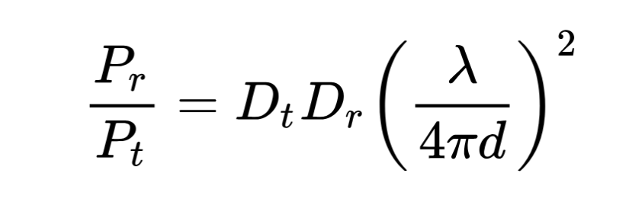
How do Satellites Communicate?
Notes:
The power that is received is dependent on 4 parameters:
1. The diameter of the dish of the transmitter Dt
2. The diameter of the dish of the receiver Dr
3. The separation distance between the transmitter and the receiver d
4. The signal wavelength lambda
So how does this relate to frequency? [ASK THIS TO THE STUDENTS]
Signal wavelength is a function of the signal speed and the frequency. We know electromagnetic waves travel at the speed of light, and we know that the speed of the signal is simply its wavelength times the frequency. Hence we can write the wavelength
As the ratio of its speed and frequency!

Slide 11
What is Modulation?

Slide 12
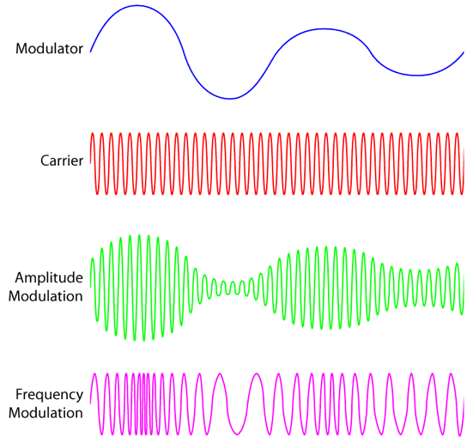
What is Modulation?
Modulator:
Carries information
Low frequency, meaning not good to send – more power required.
Carrier:
High frequency wave, very good to send,
No information, just used to “carry” something.
Notes:
We have two forms of modulation:
Amplitude modulation: we encode the amplitude of the modulator signal and increase the carrier wave amplitude to include the information inside
Frequency modulation: we encode the frequency (i.e. how close two peaks are) to the carrier wave and include the information inside.
This way, we can send our low frequency information using a high energy signal!

Slide 13
Demonstration

Slide 14
What are Possible Complications?

Slide 15
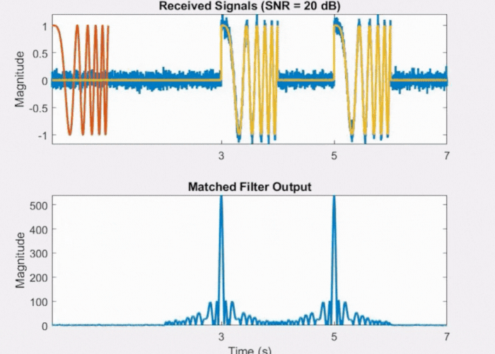
Noise
Noise can be from:
Equipment
Environment
Personal Errors
We filter out noise using averaging techniques to make sense of the signal.
When the signal-to-noise ratio decreases, then we cannot understand the signal!

Slide 16
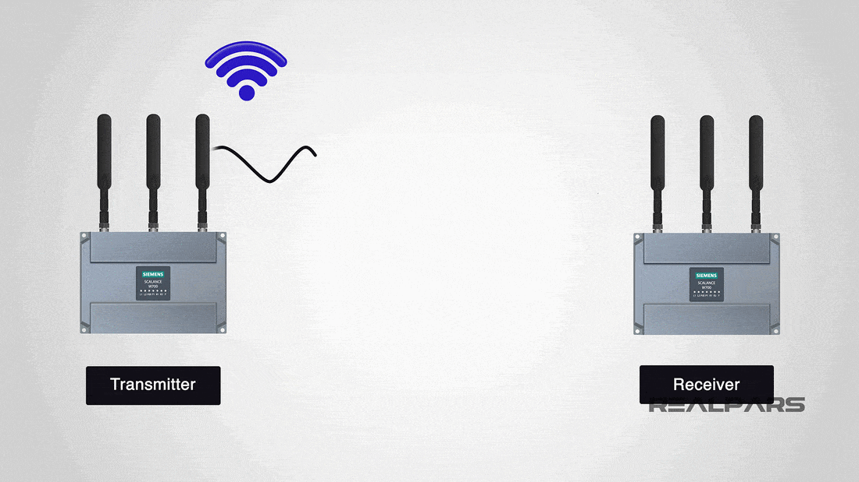
Path Loss Effects
Path loss effect occurs when the signal loses strength

Slide 17
What have we learned?
Why do satellites communicate?
Because we need to send and retrieve information, track them and adjust their errors
How do satellites communicate?
Using electromagnetic waves to transfer information
What is modulation?
We use a high frequency wave with no information, encode the information on it through modulation and send the information at less power
What are possible complications?
Noise
Path loss effects

Slide 18
Da Vinci Satellite
High School Briefing Lecture

